Slide 1
Advance OOPS concepts

Slide 2
Agenda
Programming
Procedural programming
Object oriented programming.
Features of OOP
OOP concepts
Object oriented programming design principles

Slide 3
Programming
Programming is the craft of transforming requirements into something that computer can execute.

Slide 4
Procedural programming
Programmer implements requirement by breaking down them to small steps (functional decomposition).
Programmer creates the “recipe” that computer can understand and execute.

Slide 5
Procedural programming …..
What’s wrong with procedural programming language?
When requirements change
It hard to implement new feature that were not planned in the beginning.
Code blocks gets bigger and bigger.
Changes in code introduce many bugs.
Code gets hard to maintain.

Slide 6
Worst thing is that
Requirement always change

Slide 7
Object oriented programming
Break down requirements into objects with responsibilities, not into functional steps.
Embraces change of requirements.
By minimizing changes in code.
Let you think about object hierarchies and interactions instead of program control flow.
A completely different programming paradigm.

Slide 8
Why OOPS?
To modularize software development, just like any other engineering discipline.
To make software projects more manageable and predictable.
For better maintainability, since software maintenance costs were more than the development costs.
For more re-use code and prevent ‘reinvention of wheel’** every time.
**reinventing the wheel is a phrase that means to duplicate a basic method that has already previously been created or optimized by others

Slide 9
Features of OOP
Emphasis on data rather on procedure.
Programs are divided into what are known as “objects”.
Functions that operate on data of an object are tied together in a data structure.
Object may communicate with each other through functions.
New data and functions can be added easily whenever necessary.

Slide 10
OOPS Concepts
Classes and Objects
Message and Methods
Encapsulation
Association, Aggregation and Composition
Inheritance
Polymorphism
Abstraction
Modularity
Coupling
Cohesion
Interfaces, Implementation?

Slide 11
Classes and Objects
Object oriented programming uses objects.
An object is a thing, both tangible and intangible. Account, Vehicle, Employee etc.
To create an object inside a compute program we must provide a definition for objects – how they behave and what kinds of information they maintain – called a class.
An object is called an instance of a class.
Object interacts with each other via message.

Slide 12
Message and Methods
To instruct a class or an object to perform a task, we send message to it.
You can send message only to classes and objects that understand the message you sent to them.
A class or an object must posses a matching method to be handle the received message.
A method defined for a class is called class method, and a method defined for an object is called an instance method.
A value we pass to an object when sending a message is called an argument of the message.

Slide 13
Message Passing
The process by which an object:
Sends data to other objects
Asks the other object to invoke the method.
In other words, object talks to each other via messages.

Slide 14
Encapsulation
Encapsulation is the integration of data and operations into a class.
Encapsulation is hiding the functional details from the object calling it.
Can you drive the car?
Yes, I can!
So, how does acceleration work?
Huh?
Details encapsulated (hidden) from the driver.

Slide 15
Association, Aggregation and Composition
Association → Whenever two object are related with each other the relationship is called association between objects.
Aggregation → Aggregation is specialized form of association. In aggregation objects have their own life-cycle but there is ownership and child object can not belongs to another parent object. But this is only an ownership not the life-cycle control of child control through parent object. Ex: Student and teacher, Person and address etc.
Composition → Composition is again specialize form of aggregation and we can call this as a “life and death” relationship. It is a strong type of aggregation. Child object dose not have their life-cycle and if parent object is deleted, all child object will also be deleted. Ex: House and room

Slide 16
Inheritance
Inheritance is a mechanism in OOP to design two or more entities that are different but share many common features.
Feature common to all classes are defined in the superclass.
The classes that inherit common features from the superclass are called subclasses.

Slide 17
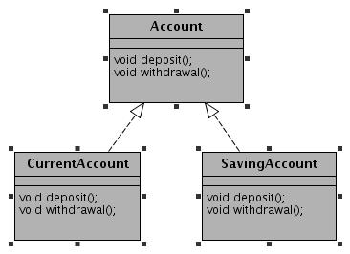
Inheritance Example

Slide 18
Why inheritance?
Classes often share capabilities.
We want to avoid re-coding these capabilities.
Reuse of these would be best to
Improve maintainability
Reduce cost
Improve “real world” modeling.

Slide 19
Why Inheritance? Benefits
No need to re-invent the wheel.
Allow us to build on existing codes without having to copy it, paste it or rewrite it again, etc.
To create the subclass, we need to program only the differences between the superclass and subclass that inherits from it.
Make class more flexible.

Slide 20
Composition(has-a)/Inheritance(is-a)
Prefer composition when not sure about inheritance.
Prefer composition when not all the superclass functions were re-used by subclass.
Inheritance leads to tight coupling b/w subclass with superclass. Harder to maintain.
Inheritance hides some of compilation error which must be exposed.
Inheritance is easier to use than composition.
Composition make the code maintainable in future, especially when your assumption breaks (Using inheritance).
Discussion is incomplete without discussion of Liskov substitution principle.

Slide 21
Composition/Inheritance…..
Idea is to think twice while making decision.
One has to have proper reason while choosing composition/inheritance.
A car has “engine”.
A car is a “vechicle”.
Discussion?

Slide 22
Polymorphism
Polymorphism indicates the meaning of “many forms”.
Polymorphism present a method that can have many definitions. Polymorphism is related to “overloading” and “overriding”.
Overloading indicates a method can have different definitions by defining different type of parameters.
getPrice() : void
getPrice(string name) : void

Slide 23
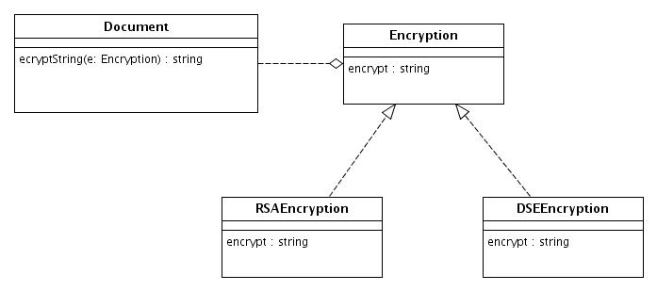
Polymorphism….
Overriding indicates subclass and the parent class has the same methods, parameters and return type(namely to redefine the methods in parent class).

Slide 24
Abstraction
Abstraction is the process of modeling only relevant features
Hide unnecessary details which are irrelevant for current for current purpose (and/or user).
Reduces complexity and aids understanding.
Abstraction provides the freedom to defer implementation decisions by avoiding commitments to details.

Slide 25
Abstraction example
#include <iostream>
using namespace std;
class Adder{
public:
// constructor
Adder(int i = 0)
{
total = i;
}
// interface to outside world
void addNum(int number)
{
total += number;
}
// interface to outside world
int getTotal()
{
return total;
};
private:
// hidden data from outside world
int total;
};
int main( )
{
Adder a;
a.addNum(10);
a.addNum(20);
a.addNum(30);
cout << "Total " << a.getTotal() <<endl;
return 0;
}

Slide 26
Modularity
The modularity means that the logical components of a large program can each be implemented separately. Different people can work on different classes. Each implementation task is isolated from the others.
This has benefits, not just for organizing the implementation, but for fixing problems later.

Slide 27
Coupling
Coupling defines how dependent one object on another object (that is uses).
Coupling is a measure of strength of connection between any two system components. The more any one components knows about other components, the tighter(worse) the coupling is between those components.

Slide 28
Tight coupling
class Traveler
{
Car c=new Car();
void startJourney()
{
c.move();
}
}
class Car
{
void move()
{
// logic...
}
}

Slide 29
Loose coupling
class Traveler
{
Vehicle v;
public void setV(Vehicle v)
{
this.v = v;
}
void startJourney()
{
v.move();
}
}
Interface Vehicle
{
void move();
}
class Car implements Vehicle
{
public void move()
{
// logic
}
}
class Bike implements Vehicle
{
public void move()
{
// logic
}
}

Slide 30
Cohesion
Cohesion defines how narrowly defined an object is. Functional cohesion refers measures how strongly objects are related.
Cohesion is a measure of how logically related the parts of an individual components are to each other, and to the overall components. The more logically related the parts of components are to each other higher (better) the cohesion of that component.
Low coupling and tight cohesion is good object oriented design (OOD).

Slide 31
Interface
An interface is a contract consisting of group of related function prototypes whose usage is defined but whose implementation is not:
An interface definition specifies the interface’s member functions, called methods, their return types, the number and types of parameters and what they must do.
These is no implementation associated with an interface.

Slide 32
Interface Example
class shape
{
public:
virtual ~shape();
virtual void move_x(distance x) = 0;
virtual void move_y(distance y) = 0;
virtual void rotate(angle rotation) = 0;
//...
};

Slide 33
Interface implementation
An interface implementation is the code a programmer supplies to carry out the actions specified in an interface definition.

Slide 34
Implementation Example
class line : public shape
{
public:
virtual ~line();
virtual void move_x(distance x);
virtual void move_y(distance y);
virtual void rotate(angle rotation); private:
point end_point_1, end_point_2;
//...
};

Slide 35
Interface vs. Implementation
Only the services the end user needs are represented.
Data hiding with use of encapsulation
Change in the class implementation should not require change in the class user’s code.
Interface is still the same
Always provide the minimal interface.
Use abstract thinking in designing interfaces
No unnecessary steps
Implement the steps in the class implementation

Slide 36
How to determine minimum possible interface?
Only what user absolutely needs
Fewer interfaces are possible
Use polymorphism
Starts with hiding everything (private)
Only use public interfaces (try not to use public attributes, instead get/set).
Design your class from users perspective and what they need (meet the requirements)

